Slide 1
Functional Conf
2018
Bengaluru, India

Slide 2
Does APL Need
a Type System?

Slide 3
Thanks,
Snoyman.

Slide 4
Aaron W. Hsu

Slide 5
APL

Slide 6
High-level

Slide 7
Magic!

Slide 8
"A light to lighten the gentiles..."

Slide 9
"Thou shalt not commune with the spirits of the dead..."

Slide 10
Weird

Slide 11
FP

Slide 12
Mainstream

Slide 13
Type System?

Slide 14
Spoiler Alert

Slide 15
Yes.

Slide 16
But...

Slide 17
You’ll be sorry...

Slide 18
Validation

Slide 19
Weirder

Slide 20
Why types?

Slide 21
Well, duh.

Slide 22
Why not?

Slide 23
Weird

Slide 24
Why

Slide 25
Types’ sake

Slide 26
“Productivity!”

Slide 27
What

Slide 28
Static Analysis

Slide 29
Linters

Slide 30
Static Type System

Slide 31
Explicit

Slide 32
Semantic Constraint

Slide 33
Syntactic Burden

Slide 34
Value?

Slide 35
Past, Present,
Future

Slide 36
Past ≡ Intent

Slide 37
Present ≡
Robustness, Performance

Slide 38
Future ≡
Code Prediction

Slide 39
Sold!

Slide 40
APL’s value

Slide 41
Intent, Robustness, Performance,
Time to Solution

Slide 42
Wut?

Slide 43
Tool of Thought

Slide 44
Solution Oriented

Slide 45
Social Context

Slide 46
Linguistic Context

Slide 47
HCI

Slide 48
Fatal Flaw

Slide 49
FP in C

Slide 50
FP in asm

Slide 51
APL in _ fails

Slide 52
Not Semantics, Syntax!

Slide 53
Intent

Slide 54
Readability

Slide 55
Not comfort

Slide 56
Confidence

Slide 57
Wanna bet?

Slide 58
Abstraction

Slide 59
Directness

Slide 60
Naming is Hard

Slide 61
Types are Structural Names

Slide 62
Distance

Slide 63
Abstraction means that the code that does what you want isn't where you think it is.
-- Edward Amsden

Slide 64
SumMultiplesOf3n5
+⌿∪,3 5×∘⍳⍤0⌈N÷3 5
+⌿(∨⌿0=3 5∘.|X)⌿X←⍳N

Slide 65
PrimeNumbersFrom0toN
(⊢~∘.×⍨)2↓⍳N
(~X∊X∘.×X)⌿X←2↓⍳N
(2=+⌿0=X∘.|X)⌿X←⍳N

Slide 66
ConnectedComponents
∨.∧

Slide 67
GameOfLife
3=s-⍵∧4=s←{+/,⍵}⌺3 3⊢⍵
⊃1 ⍵∨.∧3 4=+⌿,1 0 ¯1∘.⊖1 0 ¯1⌽¨⊂⍵

Slide 68
DeleteNodesByName
(⍳M)(⊢-1+⍸)(~M)⌿P

Slide 69
CreateBindingTable
i@(p[i←⍸t[p]=1])⍳≢p

Slide 70
RemoveBindingChains
I@{t[⍵]=1}⍣≡⍨

Slide 71
VariableMatchesBinding
(t[⍵]=1)∧n[⍵]=⍺⍺

Slide 72
LookupVariableBinding
b+⍺×0=b←bv[×∘m⍨vl I@(~m)⍣≡l[⍵]]

Slide 73
CollapseVariableAndBindingChains
bv I@{t[0⌈⍵]=1}I@{t[0⌈⍵]=10}⍣≡⍨n

Slide 74
Quiz: type the above.

Slide 75
Improvement?

Slide 76
APL is
a Type System?

Slide 77
Computing over Types

Slide 78
Rank
Shape
Index Spaces
Pointers
Data Types
Enumerations
Expressions

Slide 79
Lisp: Code is Data

Slide 80
APL: Types are Data

Slide 81
Lenore Mullin. 1988.
A Mathematics of Arrays.

Slide 82
-m⌿typ
rgb[2+typ]

Slide 83
Types Longer than Code

Slide 84
Buggier, Harder to Read

Slide 85
APL Types are Research Hard

Slide 86
Robustness/Performance

Slide 87
Infinite Tests

Slide 88
Theorems for Free

Slide 89
Compiler Analysis

Slide 90
Refactoring

Slide 91
Once upon a time...

Slide 92
free() was feeling down

Slide 93
Nobody liked him

Slide 94
No one liked to call him

Slide 95
But GC came to find him

Slide 96
GC promised to take care of him

Slide 97
GC took him to a tower

Slide 98
Filled with joyful boys and girls

Slide 99
Everyone was building happy memories

Slide 100
And GC promised free()

Slide 101
That he could play and share memories, too.

Slide 102
But free() didn't notice

Slide 103
Through all the boys and girls queuing for events

Slide 104
The name of the tower

Slide 105
Was Node.js... ;-(

Slide 106
Tune in Next time for...

Slide 107
The Perils of Lazy Par's Paralyzing Parallelization

Slide 108
Big Picture, Little Details

Slide 109
APL is High-level

Slide 110
Ultra-instinct

Slide 111
Mechanically Sympathetic

Slide 112
Modern Architectures

Slide 113
Functional data structures are like sausages, the more you see them being made, the less well you will sleep.
-- Martin Thompson

Slide 114
I don’t care what data structure you use, nothing beats an array
- a HFT Programmer

Slide 115
When it comes to arrays, nothing beats APL.

Slide 116
Shorter code is easier to debug.
-- Arthur Whitney

Slide 117
This code fits on a slide, so maintaining it is kind of silly [trivial].
-- Michael Snoyman

Slide 118
The more you can see,
the more you can know.

Slide 119
Orders of Magnitude

Slide 120
General, but specifically so.

Slide 121
Faster Iteration

Slide 122
Hyper-agile

Slide 123
Memorized

Slide 124
Deep Knowledge

Slide 125
Whole Program Rewrite

Slide 126
Technical Debt

Slide 127
Compiler Analysis

Slide 128
Trivial

Slide 129
No “types” needed

Slide 130
Simplified Optimization

Slide 131
Better high-level optimization

Slide 132
Breaking the Abstraction

Slide 133
Code Prediction

Slide 134
Type-directed Programming

Slide 135
Funnel

Slide 136
Systems Support

Slide 137
Not-human optimized

Slide 138
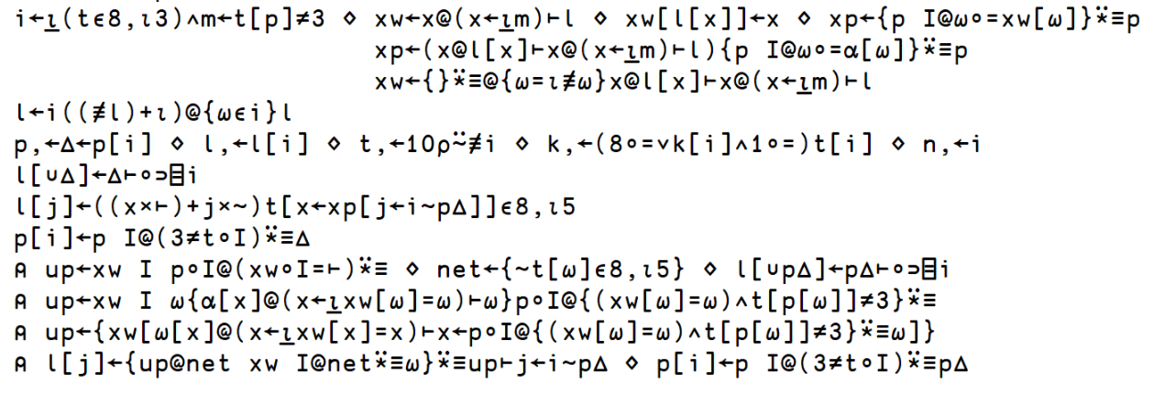

Slide 139
Suggestivity

Slide 140
Fountain

Slide 141
Serendipitous Transfer

Slide 142
Cross-domain Optimization

Slide 143
Short Code

Slide 144
Shared Foundation

Slide 145
Breakable Abstraction

Slide 146
Transparent Implementation

Slide 147
Empower Existing Knowledge

Slide 148
Leverage the Human Mind

Slide 149
Concretized Domain Overlap

Slide 150
CheckerBoard
(2|⍳12)⌽12 12⍴1 0

Slide 151
1 0 1 0 1 0 1 0 1 0 1 0
0 1 0 1 0 1 0 1 0 1 0 1
1 0 1 0 1 0 1 0 1 0 1 0
0 1 0 1 0 1 0 1 0 1 0 1
1 0 1 0 1 0 1 0 1 0 1 0
0 1 0 1 0 1 0 1 0 1 0 1
1 0 1 0 1 0 1 0 1 0 1 0
0 1 0 1 0 1 0 1 0 1 0 1
1 0 1 0 1 0 1 0 1 0 1 0
0 1 0 1 0 1 0 1 0 1 0 1
1 0 1 0 1 0 1 0 1 0 1 0
0 1 0 1 0 1 0 1 0 1 0 1

Slide 152
CheckerBoard
2|+⌿¨⍳12 12

Slide 153
0 1 2 3 4 5 6 7 8 9 10 11
1 2 3 4 5 6 7 8 9 10 11 12
2 3 4 5 6 7 8 9 10 11 12 13
3 4 5 6 7 8 9 10 11 12 13 14
4 5 6 7 8 9 10 11 12 13 14 15
5 6 7 8 9 10 11 12 13 14 15 16
6 7 8 9 10 11 12 13 14 15 16 17
7 8 9 10 11 12 13 14 15 16 17 18
8 9 10 11 12 13 14 15 16 17 18 19
9 10 11 12 13 14 15 16 17 18 19 20
10 11 12 13 14 15 16 17 18 19 20 21
11 12 13 14 15 16 17 18 19 20 21 22

Slide 154
WalkingDistanceBetweenNodes
H.Pwiz, APL Orchard
∘.(≢∪~∩)⍨(⌊∘⊃∪⊢)\⌽⍋⍋⌽d

Slide 155
RationalsAreCountable
(⍳×/s)≡I∘⍋⍨⍋⍋,+⌿¨1+⍳s

Slide 156
Code Reuse

Slide 157
via Abstraction

Slide 158
via Transparency

Slide 159
FP: Types help you document your code

Slide 160
APL: Just write clearer, shorter code

Slide 161
FP: Types help correctness

Slide 162
APL: Just rewrite clearer, shorter code more often.

Slide 163
FP: Types help performance

Slide 164
APL: Just rewrite clearer, shorter code more often with a mechanically sympathetic language.

Slide 165
FP: Types help you write new code more rigorously.

Slide 166
APL: Just rewrite clearer, shorter code more often with a mechanically sympathetic language that optimizes suggestivity to reuse idioms in more places.

Slide 167
FP: But Types!

Slide 168
APL: But APL!

Slide 169
We'd love a new type system!
Do you have one that is more economical than APL?

Slide 170
Thank you.

